Slide 1
OBJECT ORIENTED PROGRAMMING (PC-CS-203A)
UNIT-II

Slide 2
Syllabus (Unit-2)
Friend Function and Friend Classes, This Pointer, Dynamic Memory Allocation and De-allocation (New and Delete), Static Class Members, Constructors, parameter Constructors and Copy Constructors, Deconstructors
Introduction of inheritance, Types of Inheritance, Overriding Base Class Members in a Derived Class, Public, Protected and Private Inheritance, Effect of Constructors and Deconstructors of Base Class in Derived Classes.
2

Slide 3
FRIEND FUNCTIONS
If two or more classes are required to share a particular function, C++ allows a common function to be made friendly with both the classes.
This function can access the private data of these classes.
This function need not be a member of these classes.
This function can be declared as a friend of the class.
Function declaration should be preceded by keyword
friend.

Slide 4
Friend function can be defined anywhere in the program like a normal C++ function.
Function definition does not use keyword friend or scope resolution operator ::.
A function can be declared as friend in any number of classes.
A friend function can access the private members of the class.

Slide 5
Characteristics of friend function
It is not in the scope of the class to which it has been declared as a friend.
Since it is not in the scope of the class, it cannot be called using the object of that class.
It can be invoked like a normal function without the help of any object.

Slide 6
Characteristics of friend function
It cannot access the member names directly
and has to use an object
name and dot each member
membership operator with name.
It can be declared either in private or public part of the class without affecting its meaning.
Usually, it has objects as arguments.

Slide 7
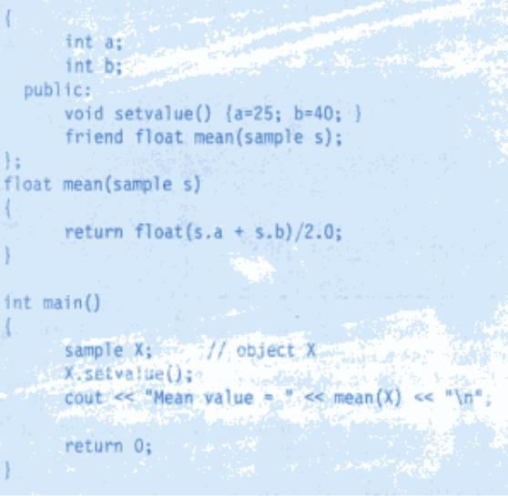

Example program

Slide 8
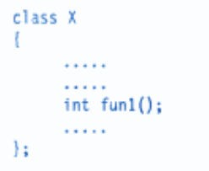

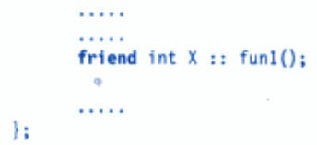
Friend Class
Members function of one class can be friend function of another class.
Then they are defined using scope resolution operator.
In the example below:
fun1() is a member of class X and friend of class Y.

Slide 9
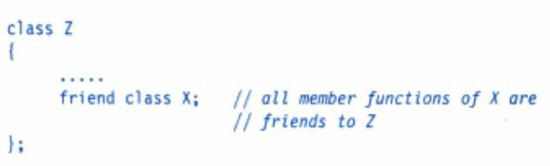
All the member functions of one class can be declared as friend functions of another class.
The class is thus called a friend class.

Slide 10
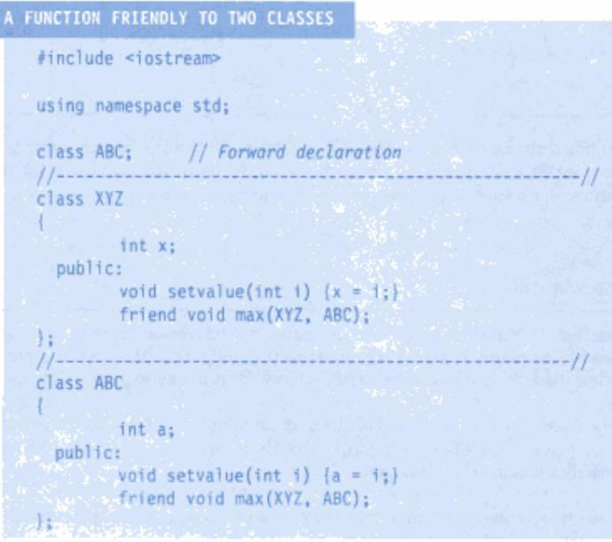
Example Program

Slide 11
